Slide 1
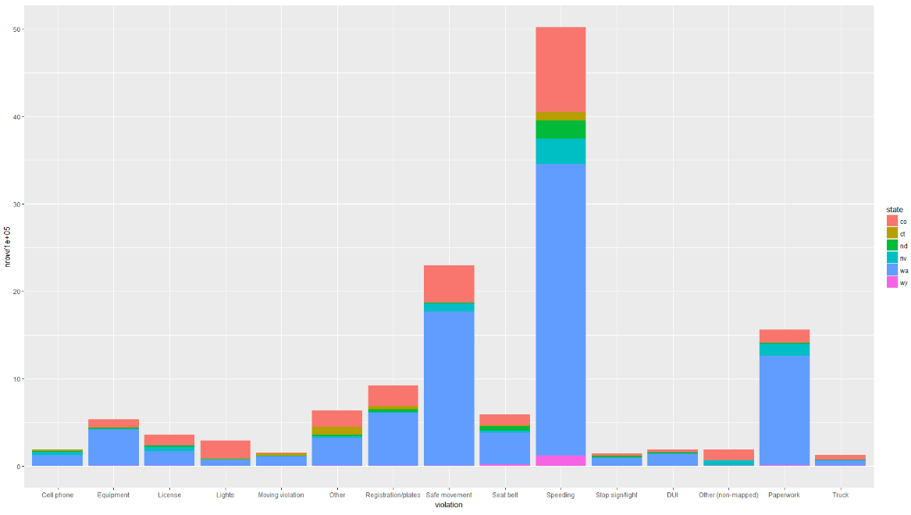
Report – 16/04/2018: Stanford Policing Dataset
In-scope states
5 states including Speeding, Cell Phone, DUI relevant records (Top 3 causes of car accident in USA: speeding, cell phone (text, calling), DUI)
Target 3 states firstly that share the majority of the violation: Colorado (pink) , Nevada (Aqua), Washington (Blue)

Slide 2
Part I
Relevant Demographic Statics
Age Group Distribution in the licensed driver
Age Group Distribution in the traffic offender

Slide 3
Demographic Overview
State | Population | Licensed Driver | Offenders | % LD ~ P | % O ~ LD | Year
Colorado | 5,029,196 5,456,574 (8.5%) | 3,779,273 3,974,521 (5.2%) | 481,434 410,479 (14.74%) | 75.15 72.84 | 12.74 10.33 | 2010 2015
Nevada | 2,700,551 2,890,845 (7%) | 1,728,060 1,835,511 (6.2%) | 138,130 216,477 (56.72%) | 63.99 63.49 | 7.99 11.79 | 2013 2015
Washington | 6,724,540 7,170,351 (6.6%) | 5,026,521 5,516,134 (9.7%) | 1,246,132 1,228,788 (1.4%) | 74.75 76.93 | 24.79 22.28 | 2009 2015
Washington has the biggest population and the highest patrol-stop rate.
Washington has similarity in the percentage of Licenced Driver out of the total population with Colorado state in respective year, however, its traffic offending rate is nearly doubled comparing with Colorado’s.
The traffic offending rate of Nevada is increasing by about 60% within 2 years.
The population of licensed driver of Colorado is more than double of that of Nevada, however, its patrol-stop rate is slightly better than that of Nevada in 2015.
IS THE INCREASE OF THE VIOLATION DETERMINED BY THE INCREASE POPULATION OR LICENSED DRIVER? NO!!!!

Slide 4
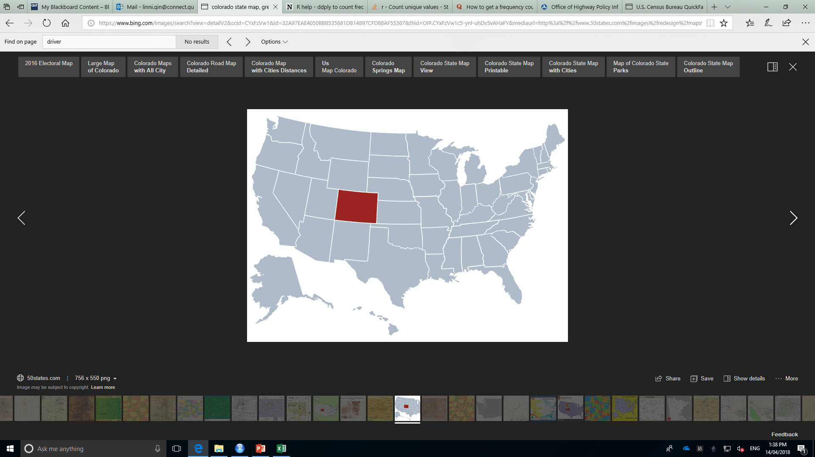
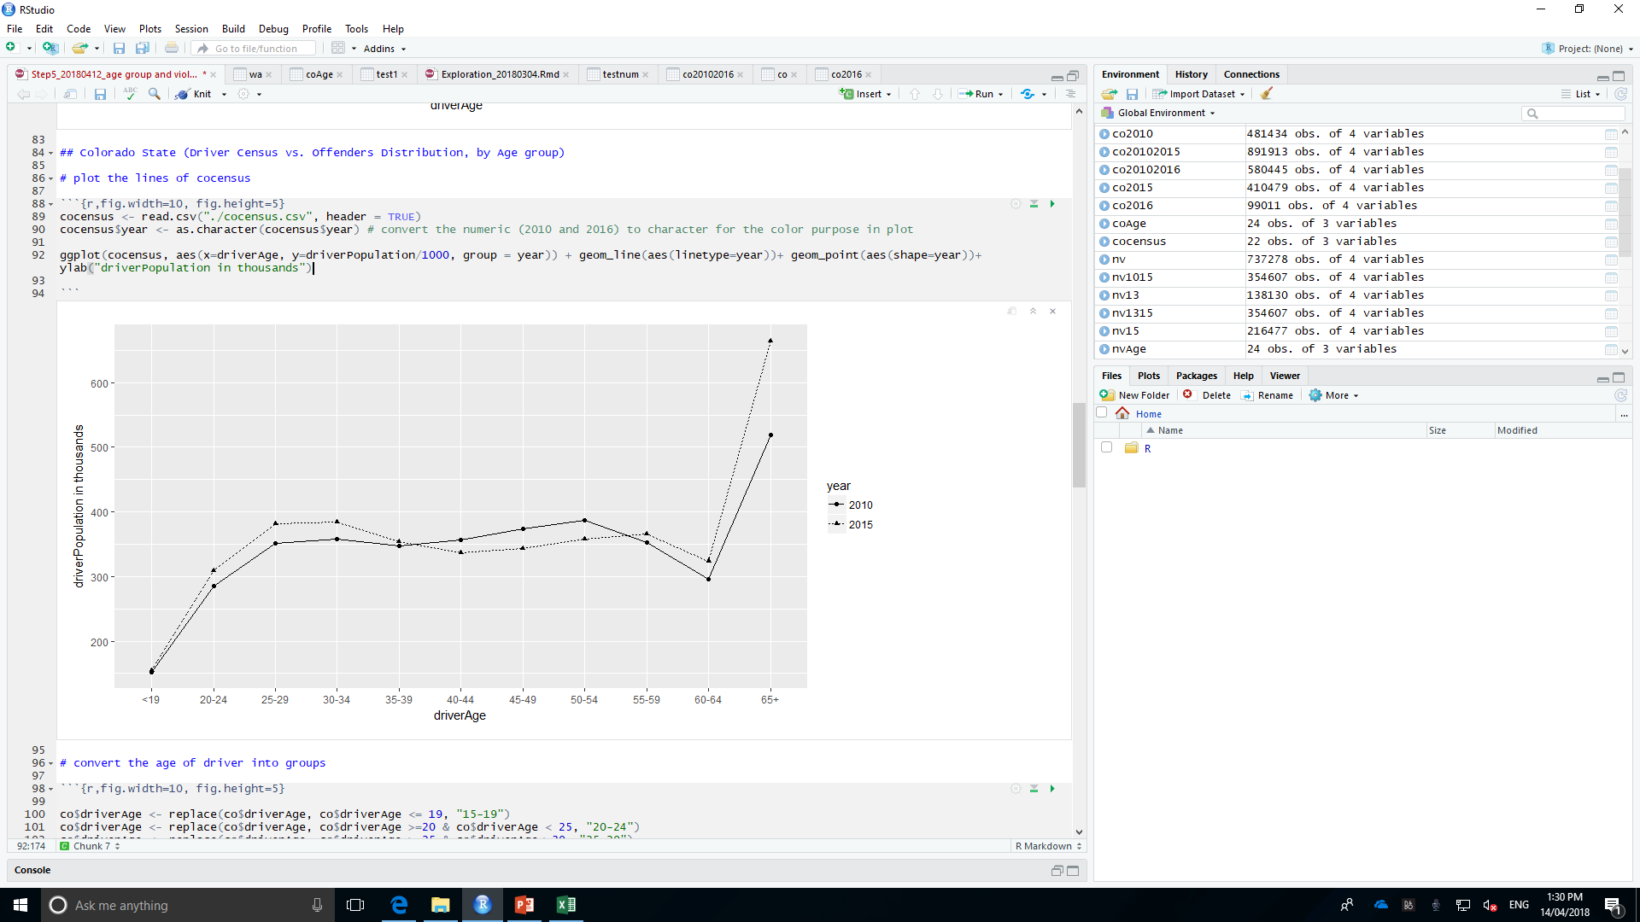
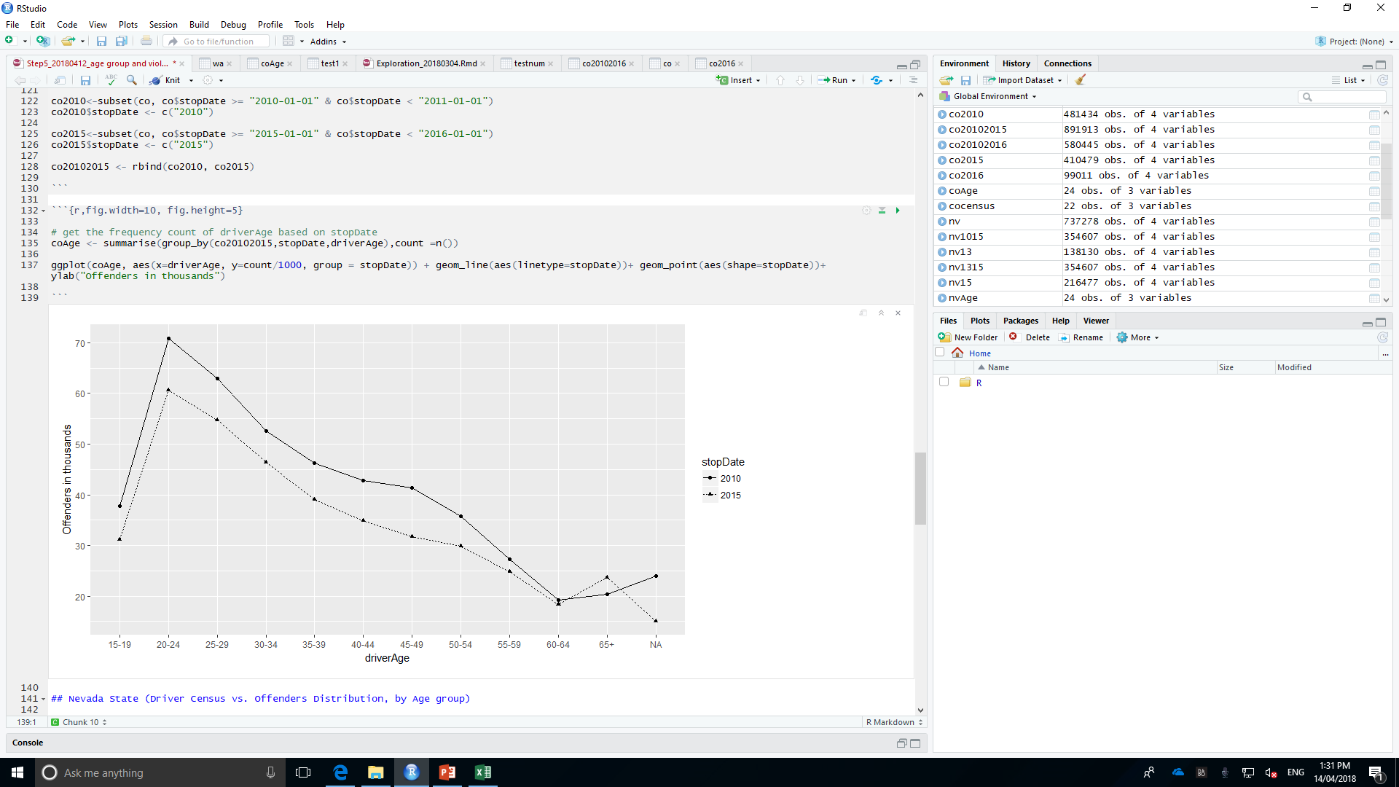
https://www.50states.com
Colorado State Licenced Drivers Demography, by Age Group (2010/2015)
Colorado State Traffic Offenders Distribution, by Age Group (2010/2015)
Total Licenced Driver: 3,974,521 (2015)
Total Offenders: 410,479 (2015)
Age group 20-24 contribute the highest traffic offending rate, then 25- 29.
It can be concluded that more elder the driver is, less offending behaviours.
The general patrol-stop rate obviously decreased from 2010 to 2015.
The licensed driver has a balanced distribution by age group excluding the one under 19 and over 60.

Slide 5
Colorado State Licensed Driver Statics, by Age Group (2010/2015)
Colorado State Offender Statics, by Age Group (2010/2015)
Age Group | 2010 | 2015 | %
<19 | 151876 | 153878 | 1.32%
20-24 | 285219 | 309449 | 8.50%
25-29 | 351224 | 381407 | 8.59%
30-34 | 357668 | 384672 | 7.55%
35-39 | 347129 | 354024 | 1.99%
40-44 | 356685 | 336385 | -5.69%
45-49 | 374250 | 343226 | -8.29%
50-54 | 387416 | 357392 | -7.75%
55-59 | 352159 | 365818 | 3.88%
60-64 | 296304 | 324140 | 9.39%
65+ | 519343 | 664130 | 27.88%
Age Group | 2010 | 2015 | %
15-19 | 37836 | 31136 | -17.71%
20-24 | 70822 | 60690 | -14.31%
25-29 | 63000 | 54751 | -13.09%
30-34 | 52591 | 46364 | -11.84%
35-39 | 46199 | 39078 | -15.41%
40-44 | 42882 | 34940 | -18.52%
45-49 | 41369 | 31763 | -23.22%
50-54 | 35777 | 29860 | -16.54%
55-59 | 27238 | 24798 | -8.96%
60-64 | 19263 | 18304 | -4.98%
65+ | 20431 | 23722 | 16.11%
NA | 24026 | 15073 | -37.26%

Slide 6
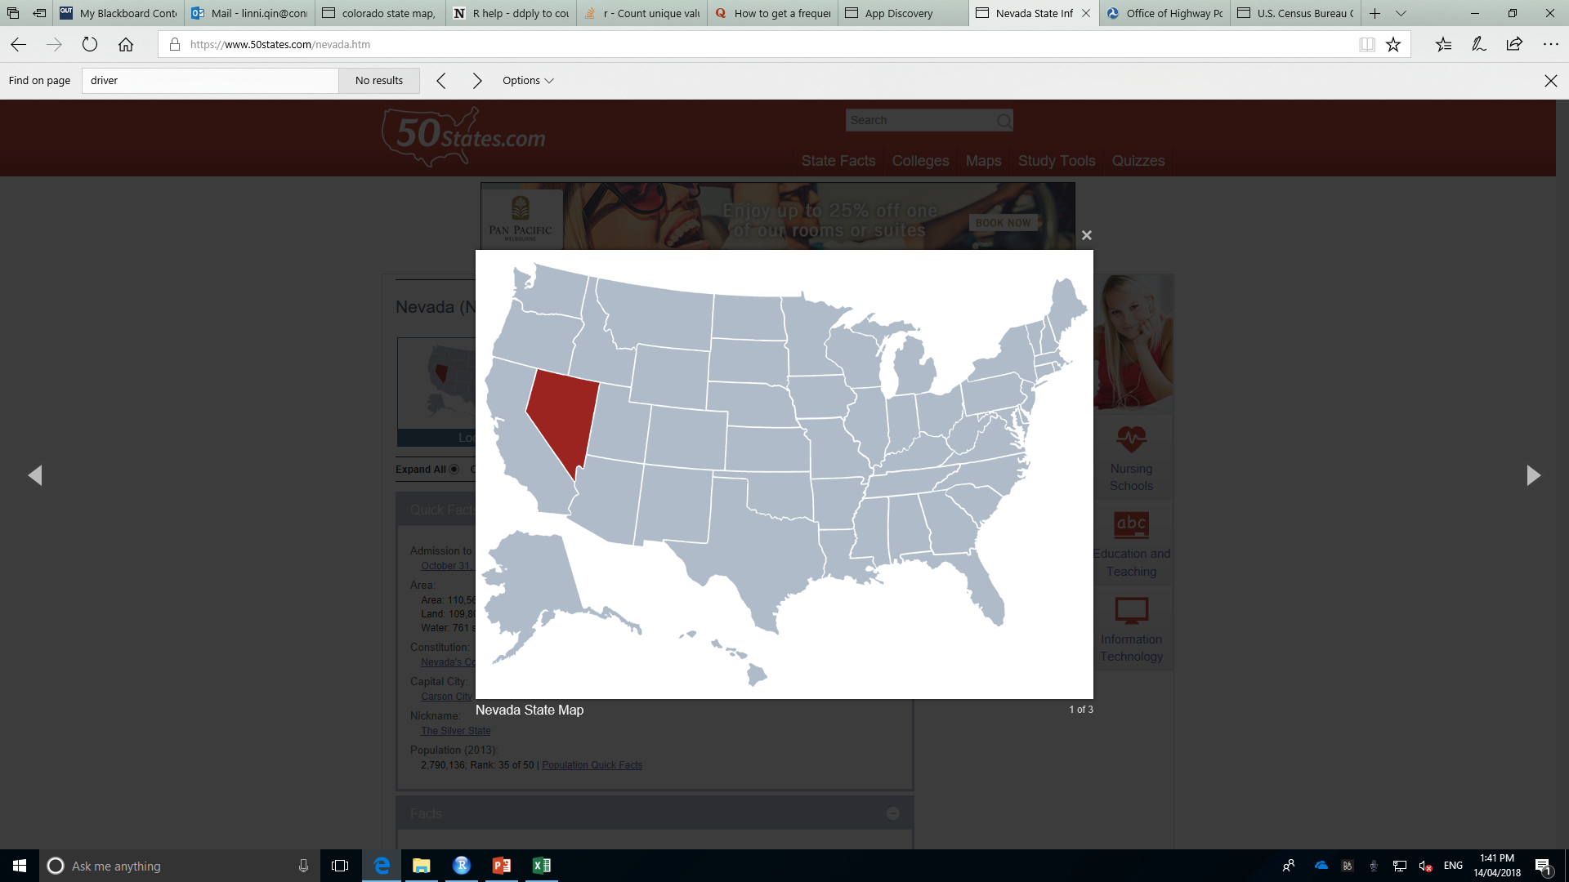
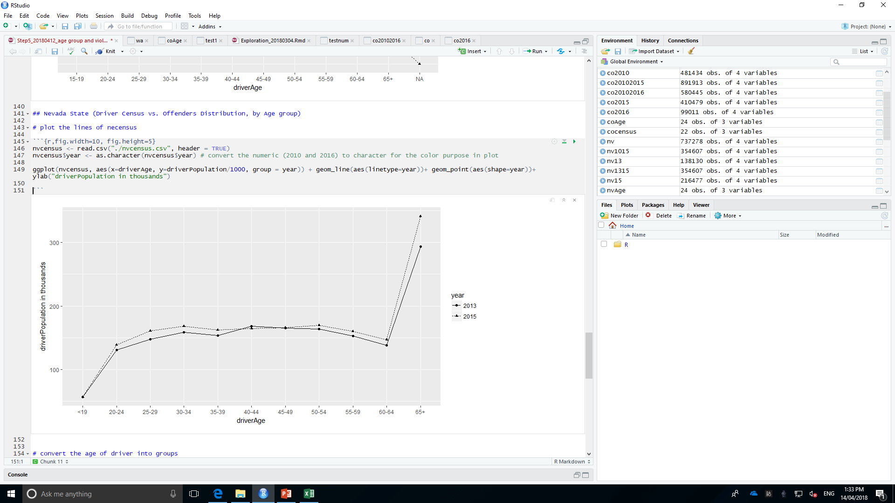
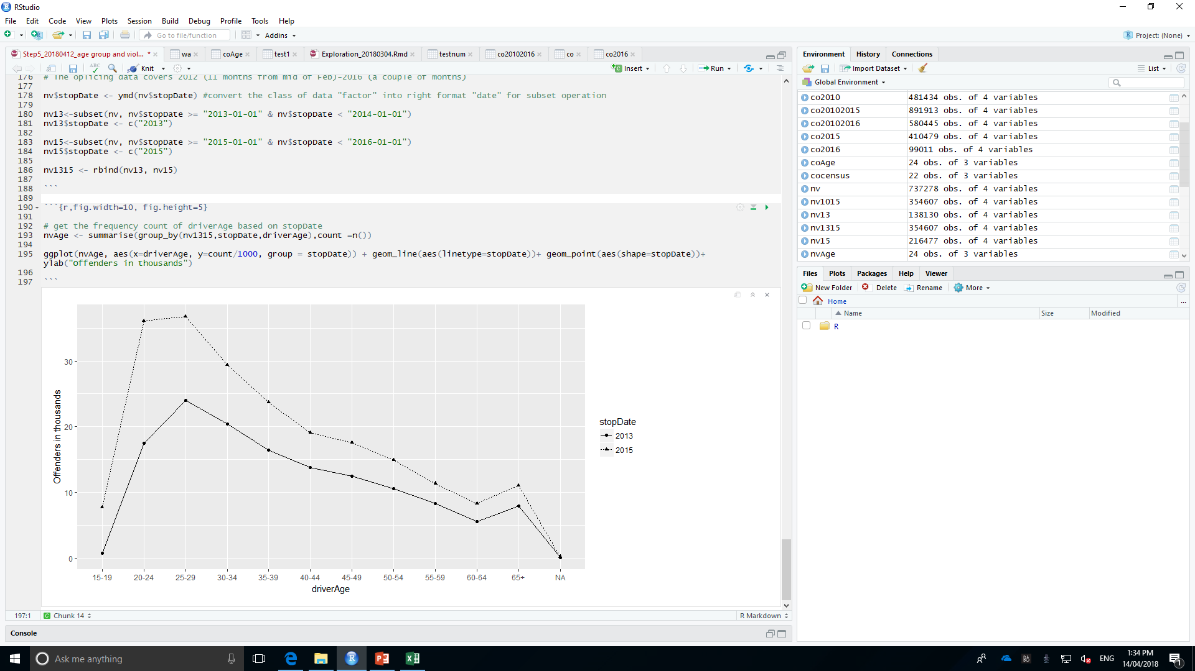
https://www.50states.com
Nevada State Licenced Drivers Demography, by Age Group (2012/2015)
Nevada State Traffic Offenders Distribution, by Age Group (2012/2015)
Total Offenders: 216,477 (2015)
Total Licenced Driver: 341,222 (2015)
The licensed driver has a balanced distribution by age group excluding the one under 19 and over 60.
The general patrol-stop rate apparently increased from 2013 to 2015.
Different with other two states, age group 25-29 resulted in the highest traffic offending behaviours and then 30-34.

Slide 7
Nevada State Age Group (2013/2015)
Age Group | 2013 | 2015 | %
<19 | 56572 | 56776 | 0.36%
20-24 | 130382 | 138968 | 6.59%
25-29 | 147679 | 160799 | 8.88%
30-34 | 158253 | 168415 | 6.42%
35-39 | 153525 | 162416 | 5.79%
40-44 | 167856 | 164446 | -2.03%
45-49 | 165224 | 166173 | 0.57%
50-54 | 163773 | 169279 | 3.36%
55-59 | 153024 | 160356 | 4.79%
60-64 | 138351 | 146661 | 6.01%
65+ | 293421 | 341222 | 16.29%
Age Group | 2013 | 2015
15-19 | 769 | 7799 | 914.17%
20-24 | 17478 | 36090 | 106.49%
25-29 | 24046 | 36728 | 52.74%
30-34 | 20394 | 29414 | 44.23%
35-39 | 16496 | 23745 | 43.94%
40-44 | 13786 | 19106 | 38.59%
45-49 | 12472 | 17569 | 40.87%
50-54 | 10600 | 14939 | 40.93%
55-59 | 8316 | 11409 | 37.19%
60-64 | 5641 | 8345 | 47.93%
65+ | 7987 | 11055 | 38.41%
NA | 145 | 278 | 91.72%

Slide 8
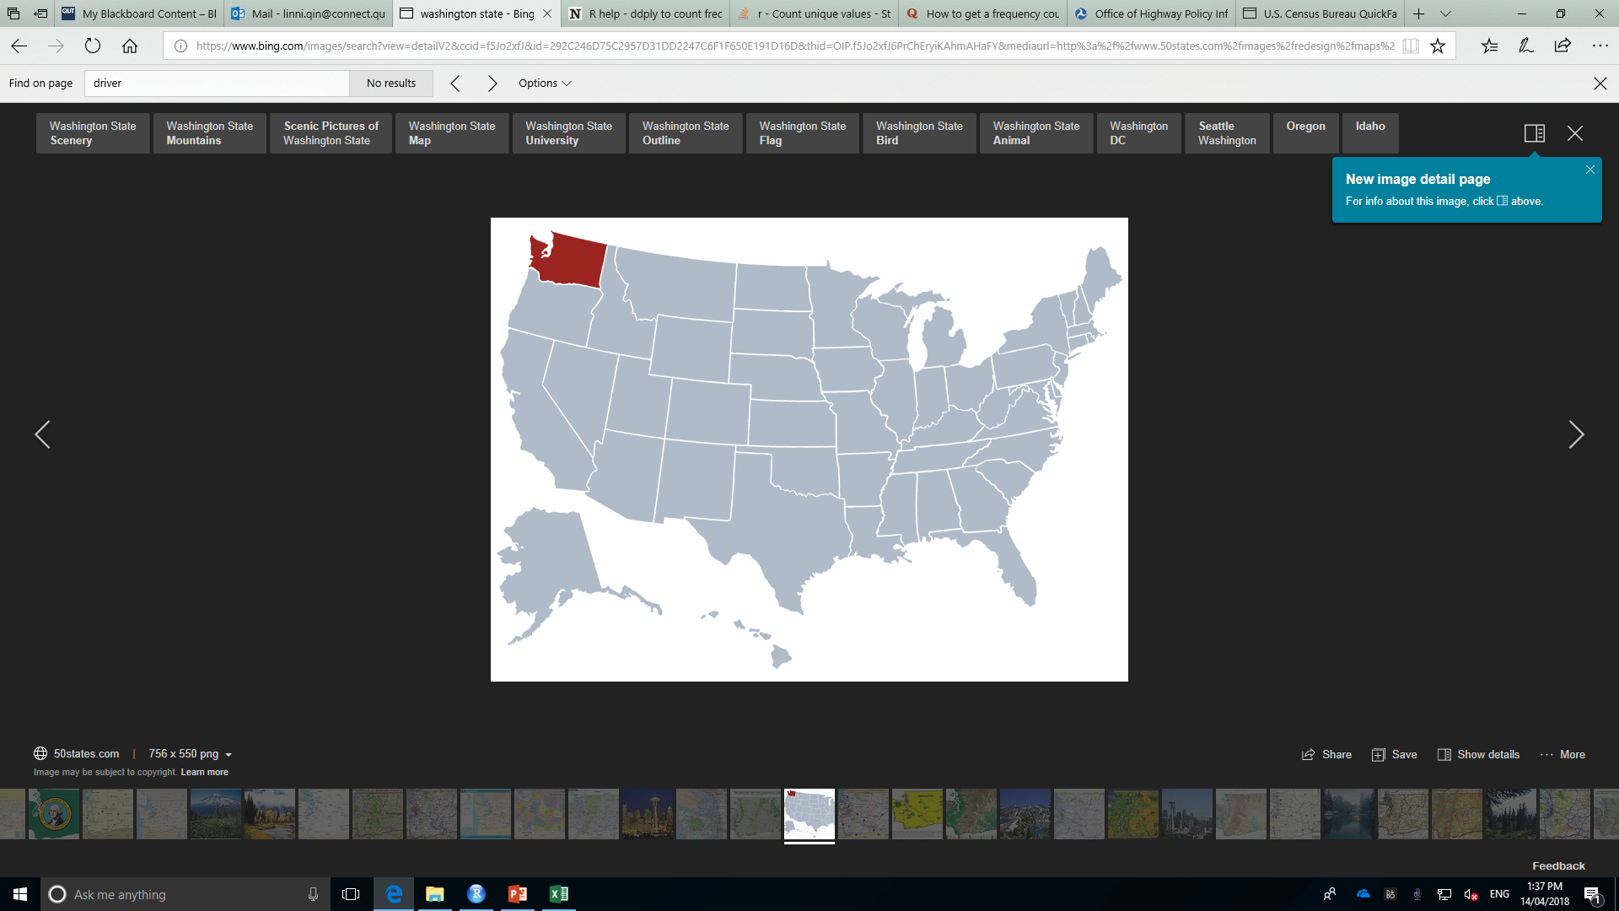
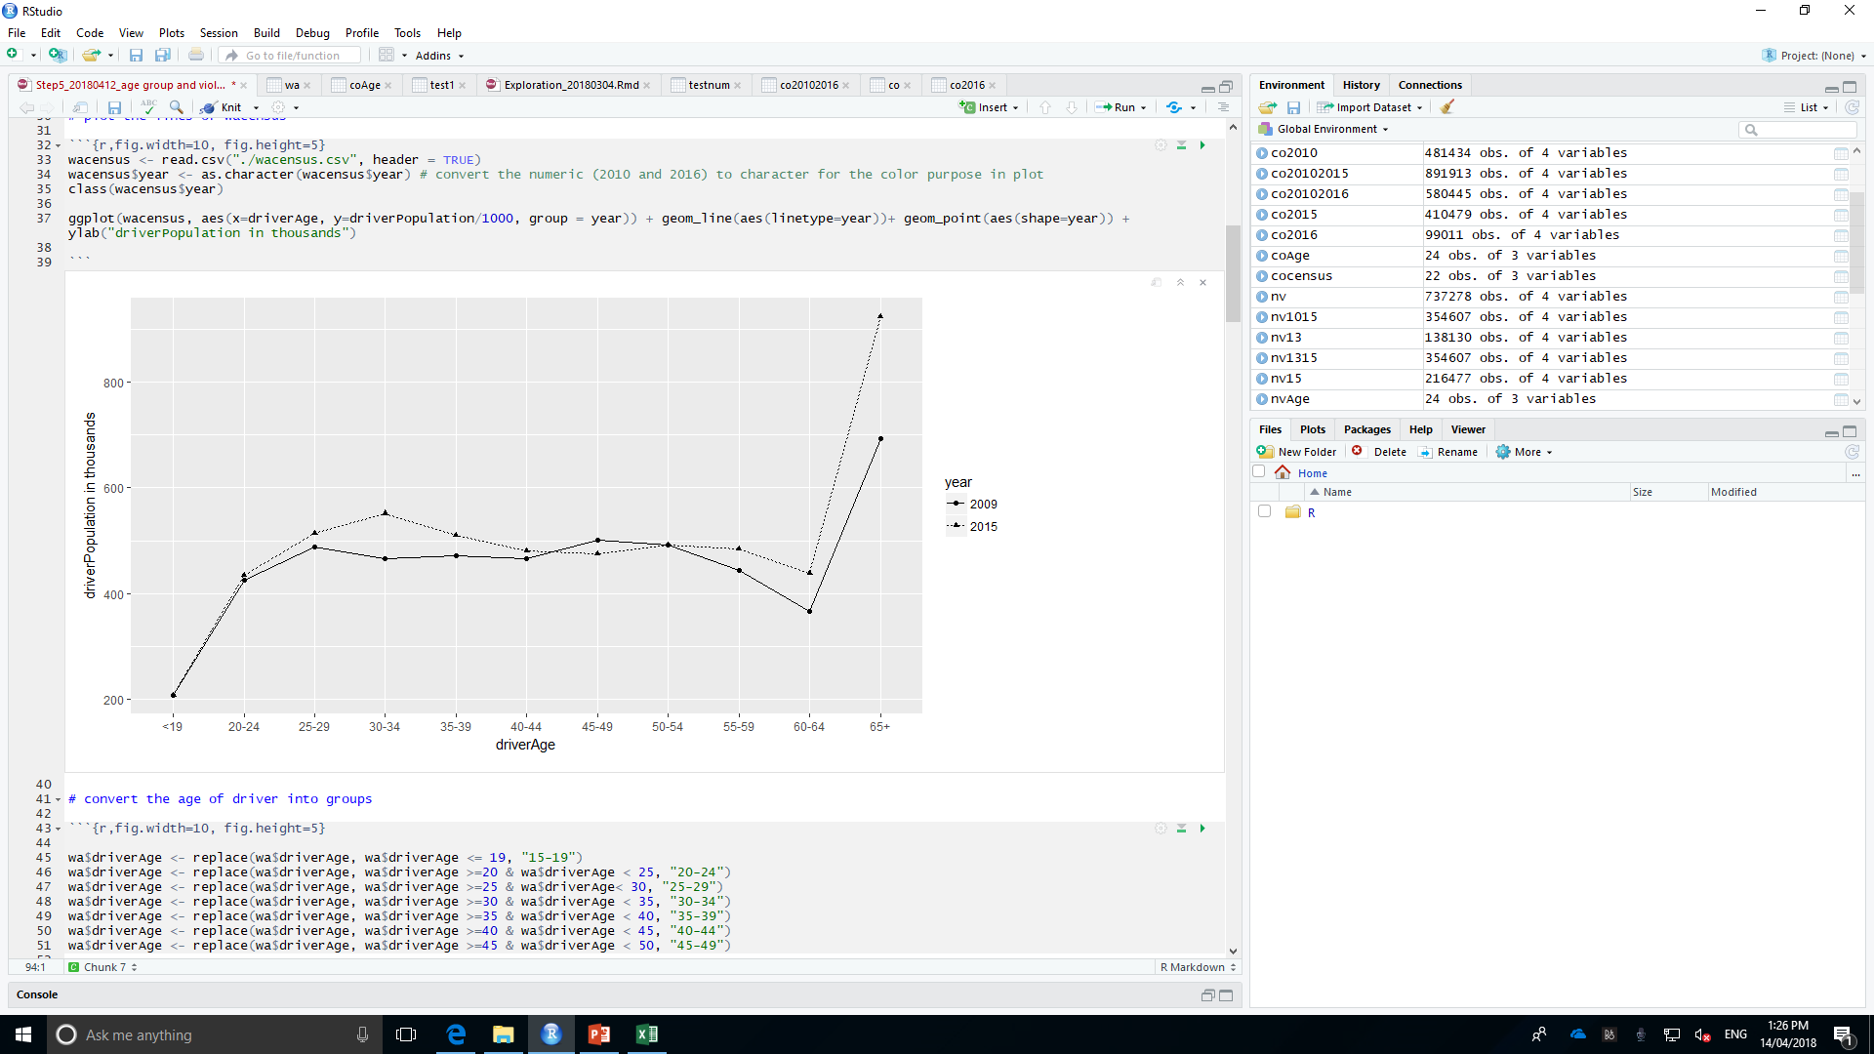
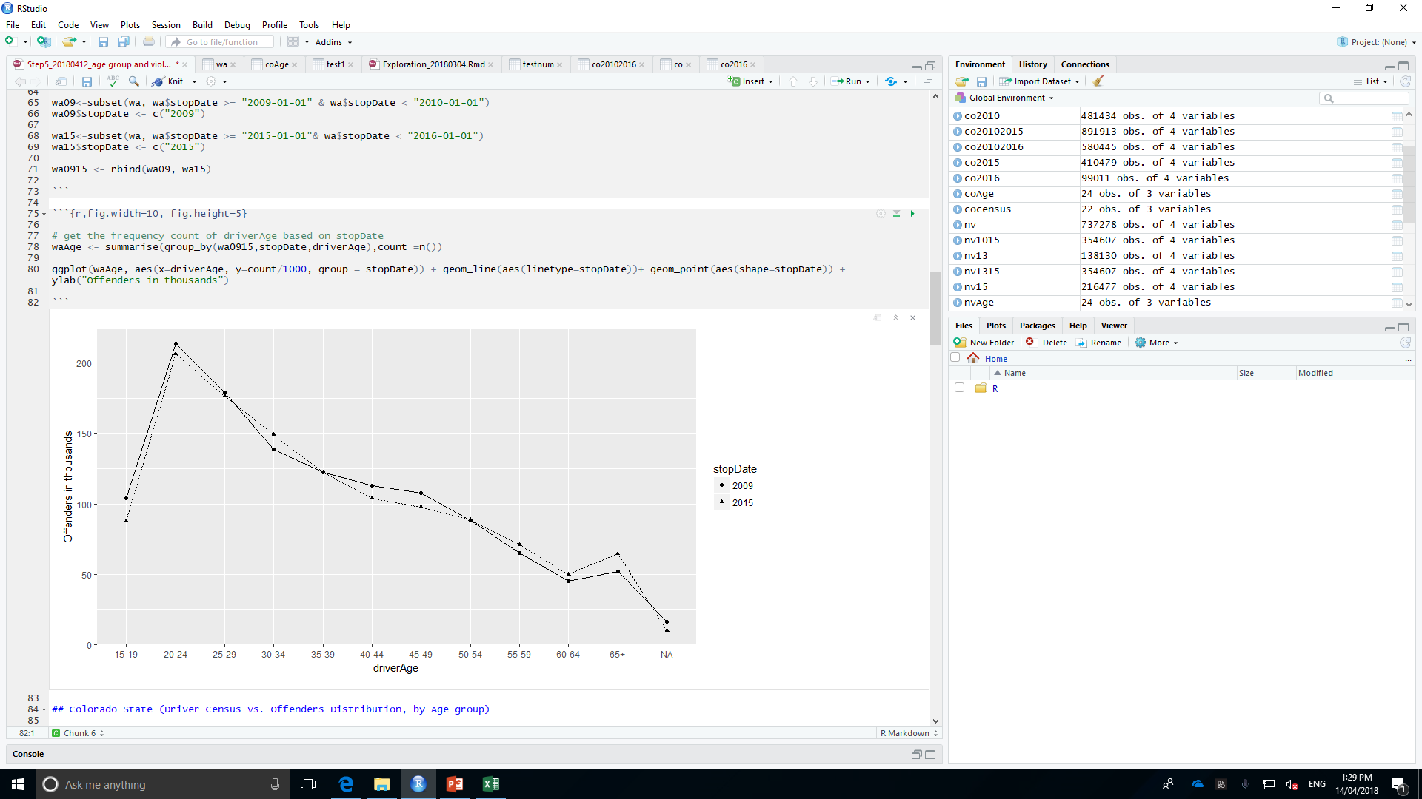
https://www.50states.com
Washington State Licenced Drivers Demography, by Age Group (2009/2015)
Washington State Traffic Offenders Distribution, by Age Group (2009/2015)
Total Licenced Driver: 5,516,134 (2015)
Total Offenders: 1,228,788 (2015)
The licensed driver has a balanced distribution by age group excluding the one under 19 and over 60.
Age group 20-24 contribute the highest traffic offending rate, then 25- 29.
It can be concluded that more elder the driver is, less offending behaviours.

Slide 9
Washington State Licensed Driver Statics, by Age Group (2009/2015)
Washington State Offender Statics, by Age Group (2009/2015)
Age Group | 2009 | 2015 | %
<19 | 208521 | 208357 | -0.08%
20-24 | 425775 | 434218 | 1.98%
25-29 | 489186 | 514543 | 5.18%
30-34 | 466453 | 551890 | 18.32%
35-39 | 472560 | 510850 | 8.10%
40-44 | 466027 | 481604 | 3.34%
45-49 | 501776 | 475051 | -5.33%
50-54 | 492567 | 492469 | -0.02%
55-59 | 443385 | 485118 | 9.41%
60-64 | 367099 | 439005 | 19.59%
65+ | 693172 | 923029 | 33.16%
Age Group | 2009 | 2015 | %
15-19 | 104012 | 87588 | -15.79%
20-24 | 213728 | 206619 | -3.33%
25-29 | 179261 | 176570 | -1.50%
30-34 | 138766 | 149301 | 7.59%
35-39 | 122356 | 122338 | -0.01%
40-44 | 112965 | 104259 | -7.71%
45-49 | 107827 | 97806 | -9.29%
50-54 | 88440 | 88969 | 0.60%
55-59 | 65048 | 70870 | 8.95%
60-64 | 45284 | 49970 | 10.35%
65+ | 52177 | 64475 | 23.57%
NA | 16268 | 10023 | -38.39%

Slide 10
Part II
General Violation Exploration
Washington Traffic Violation and Age Groups Distribution (2009 vs. 2015)
Colorado Traffic Violation and Age Groups Distribution (2010 vs. 2015)
Nevada Traffic Violation and Age Groups Distribution (2013 vs. 2015)

Slide 11
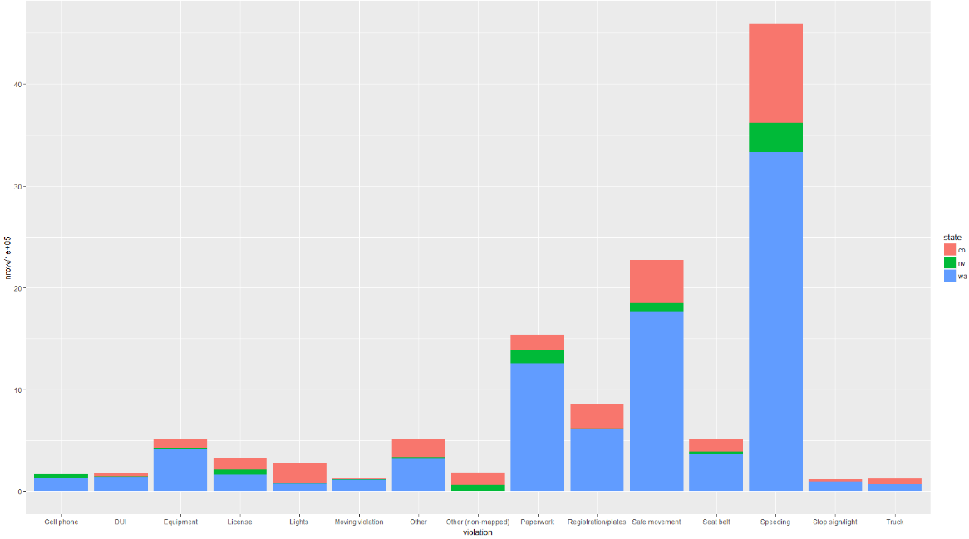
Top 3 Violations
Speeding
Safe Movement ( car wrecked) ???? Is Safe Movement (wrecked car) record resulted from speeding, dui, cell phone?
Paperwork ???? Is Paperwork involved with DUI or other traffic crimes?
Therefore, TO DO: Explore mainly the distribution of Speeding, DUI, Cell Phone with varied age groups

Slide 12
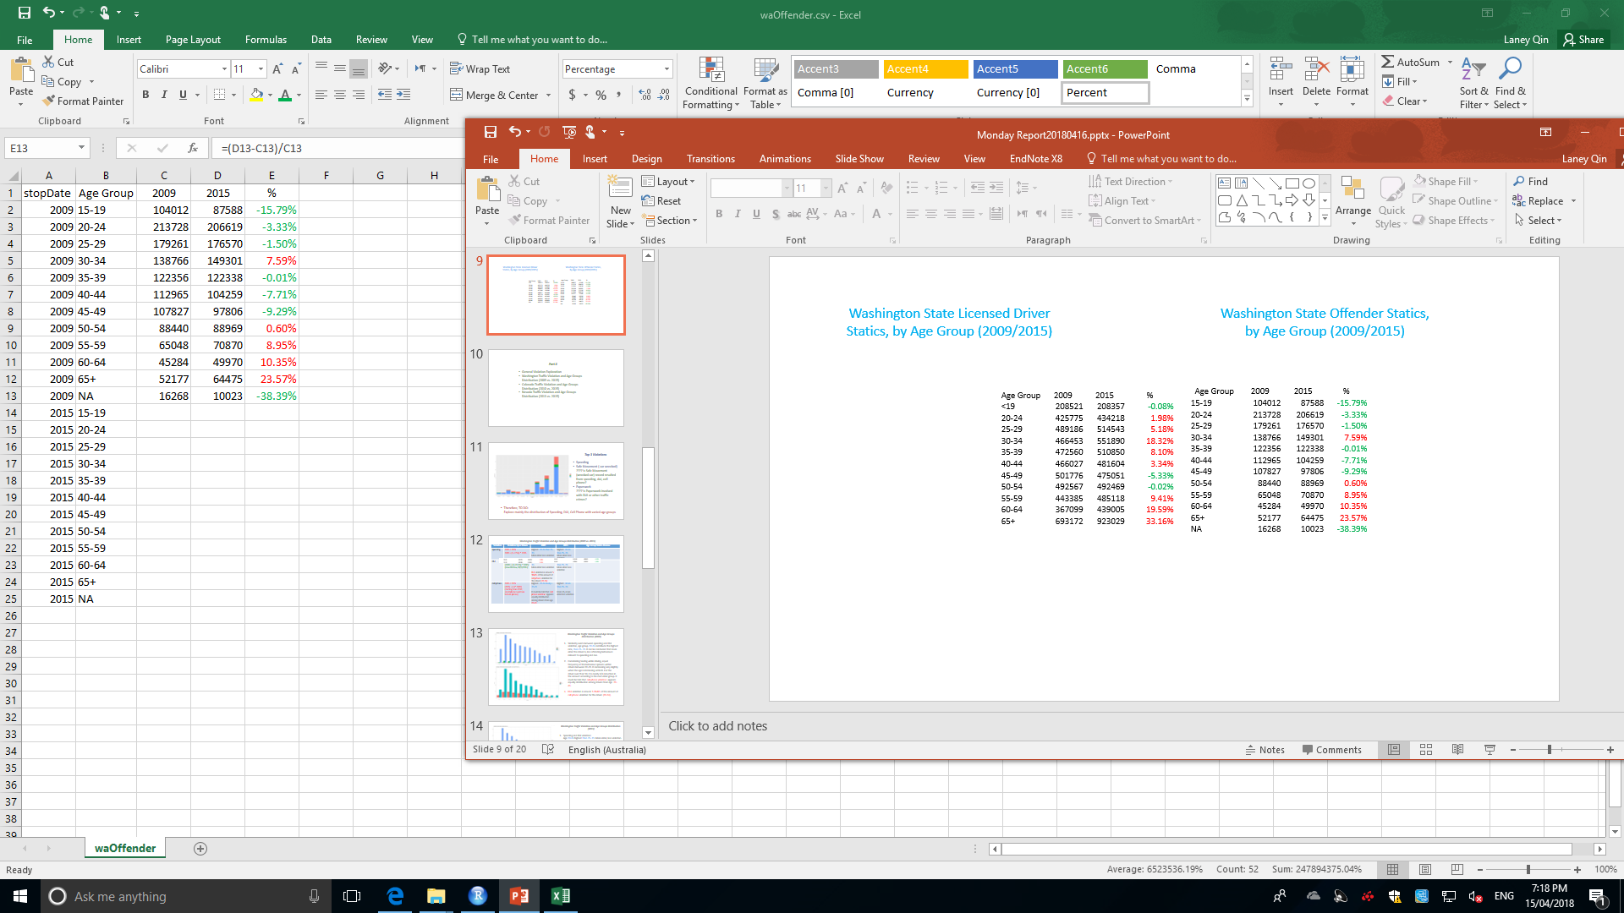
Washington Traffic Violation and Age Groups Distribution (2009 vs. 2015)
Violation | Violation Up or Down | 2009 | 2015 | Age Group Statics Review
Speeding | 2009 < 2015 2009 = (1- 2.5%) * 2015 | Highest: 20-24 then 25- 29. More elder Less violation | Highest: 20-24 then 25- 29. More elder Less violation
DUI | 2009 > 2015 (2009 = (1+21.5%) * 2015) (new DUI law, 28/9/2013) | Highest: 20-24 then 25- 29. More elder Less violation DUI violation is around 5 TIMES of the amount of cell phone violation for the driver (20-24) | Highest: 20-24 then 25- 29. More elder Less violation
Cell phone | 2009 < 2015 (2015 = 4.3* 2009) (starting from 2012, smartphone overtook feature phone) | Highest: 20-24 nearly = 25-29 It could be told that cell phone violation appears equally distribution among drivers from age 20-49. | Highest: 30-34 then 25- 29. From 35, more elder less violation
IS THE INCREASE OF THE VIOLATION DETERMINED BY THE INCREASE OF THE DRIVER? NO – by exploring the violation in age groups of Washington.

Slide 13
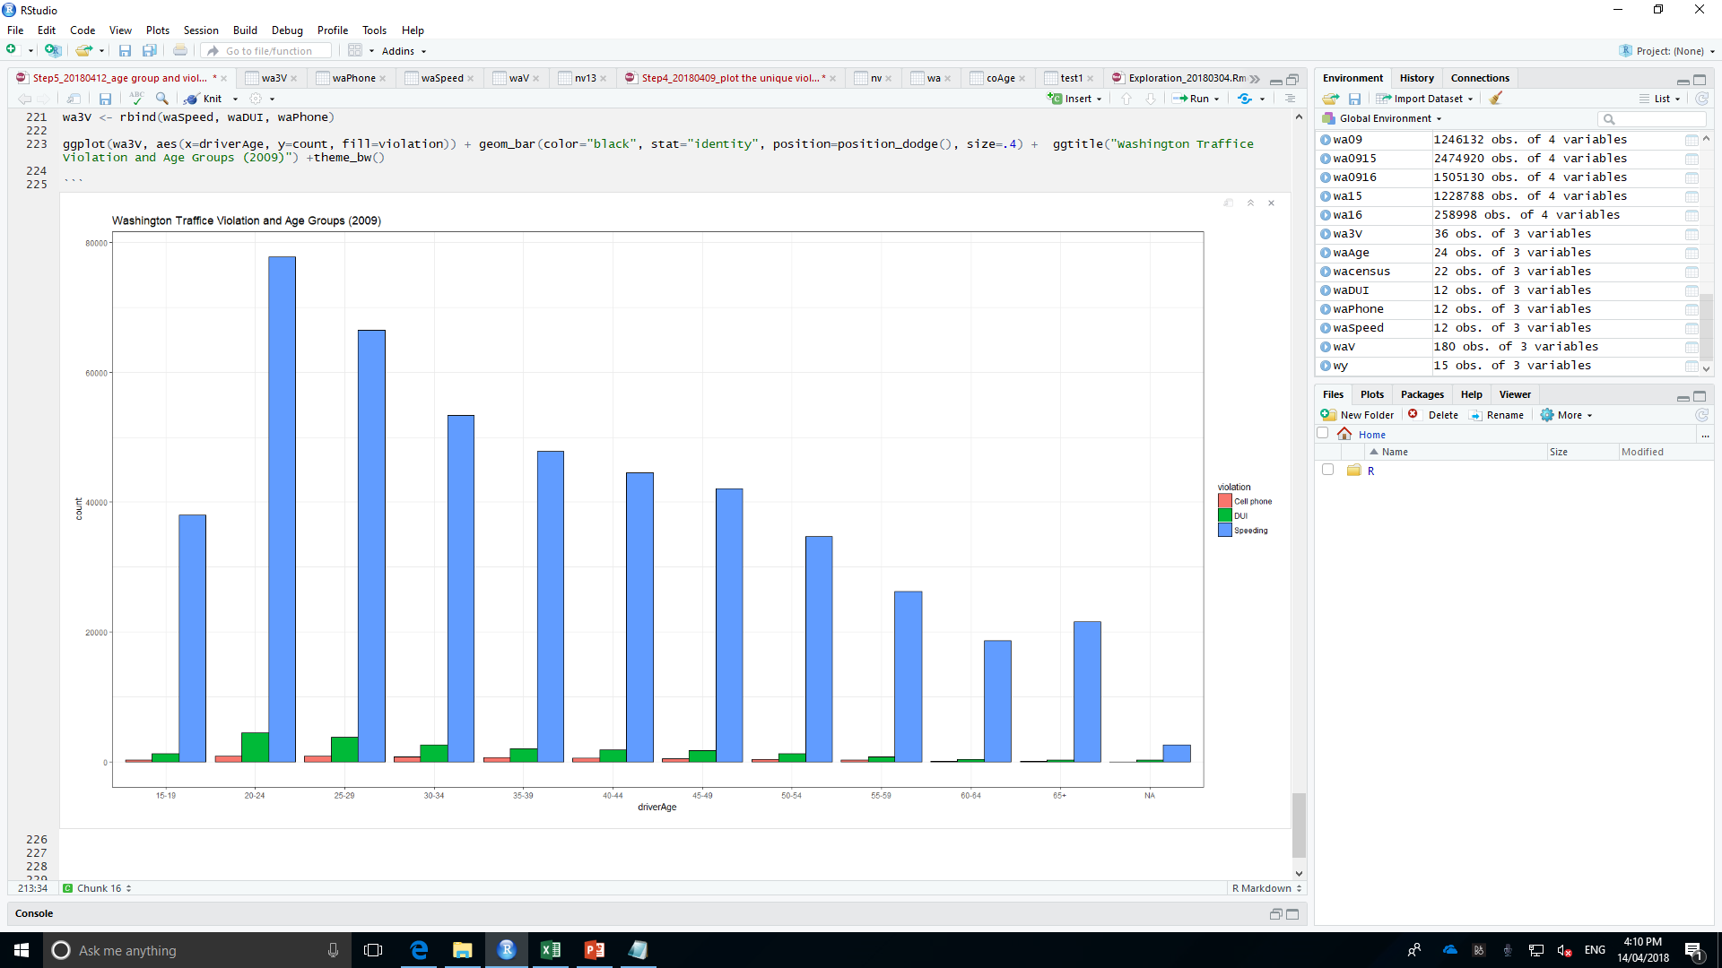
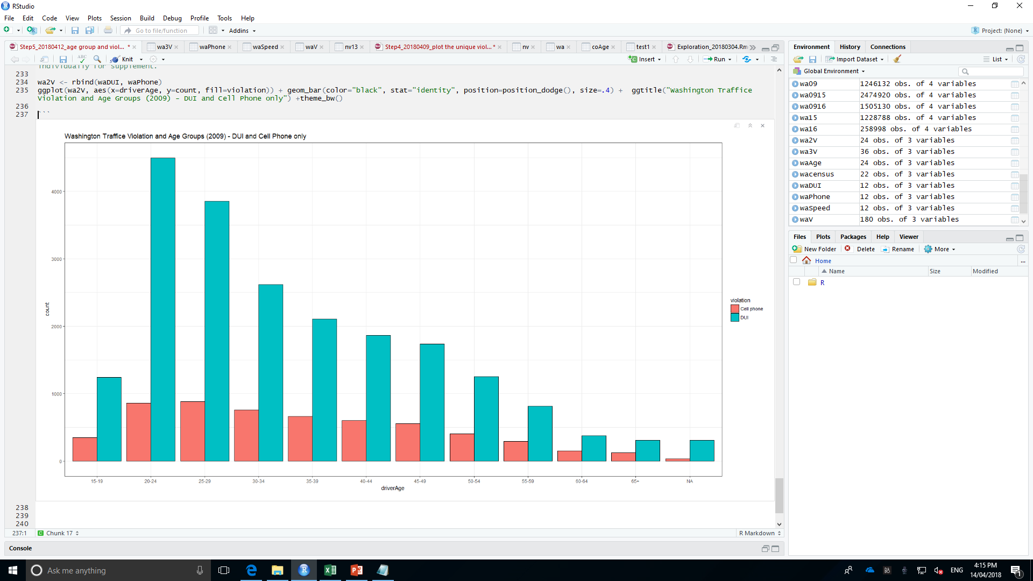
Washington Traffic Violation and Age Groups Distribution (2009)
Similarity exists between speeding and DUI violation, age group 20-24 contribute the highest rate, then 25- 29. It can be concluded that more elder the driver is, less offending behaviours relevant to speeding and dui.
Considering texting while driving, equal frequency of this behaviour spreads within drivers between 20-29. It decreasing very slightly when the age is increasing until 49. For the driver over than 50, it is nearly 1/3 reduction in the amount according to the next elder group. It could be told that cell phone violation appears equally distribution among drivers from age 20-49.
DUI violation is around 5 TIMES of the amount of cell phone violation for the driver (20-24).

Slide 14
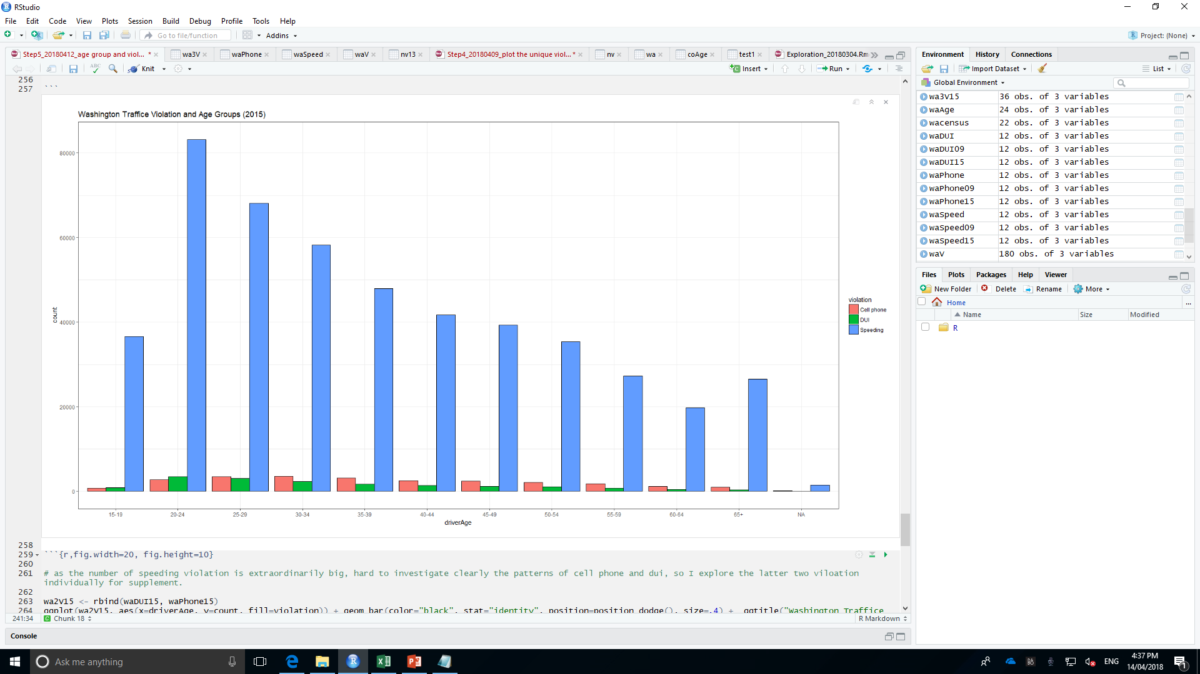
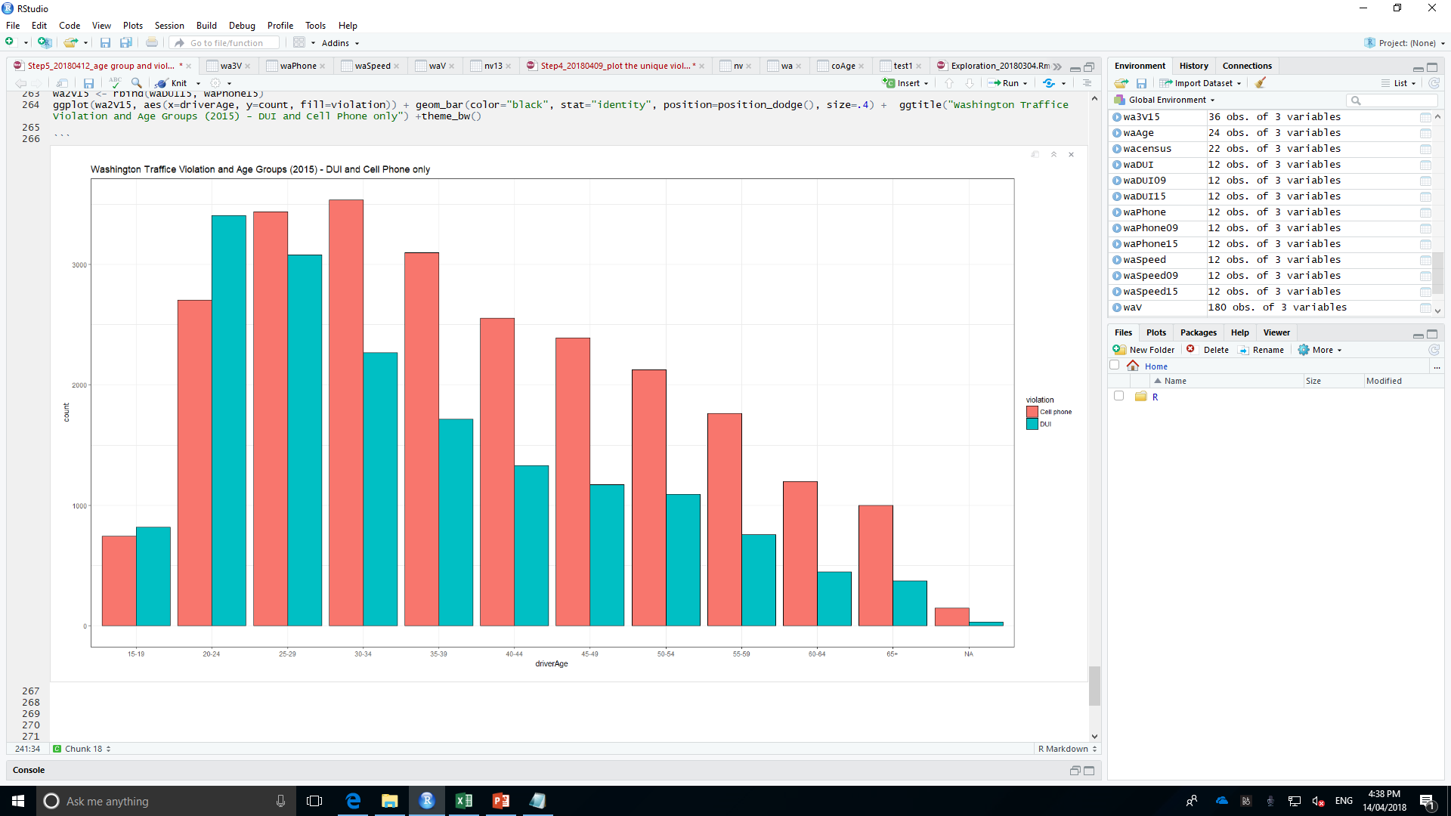
Washington Traffic Violation and Age Groups Distribution (2015)
Speeding and DUI violation: Age 20-24 highest then 25- 29. More elder, less violation.
The distribution of DUI appears the same status but 1/3 less than the respective amount of 2009.
Cell phone violation boosted up to more than 3 TIMES of respective amount of 2009.
DUI violation is around 1/5 higher than the amount of cell phone violation for the driver under 24. Nevertheless, starting from driver aging 25, the driving distraction by the cell phone appears worse and worse than DUI.
Drivers (30-34) conduct the worst group related to cell pone

Slide 15
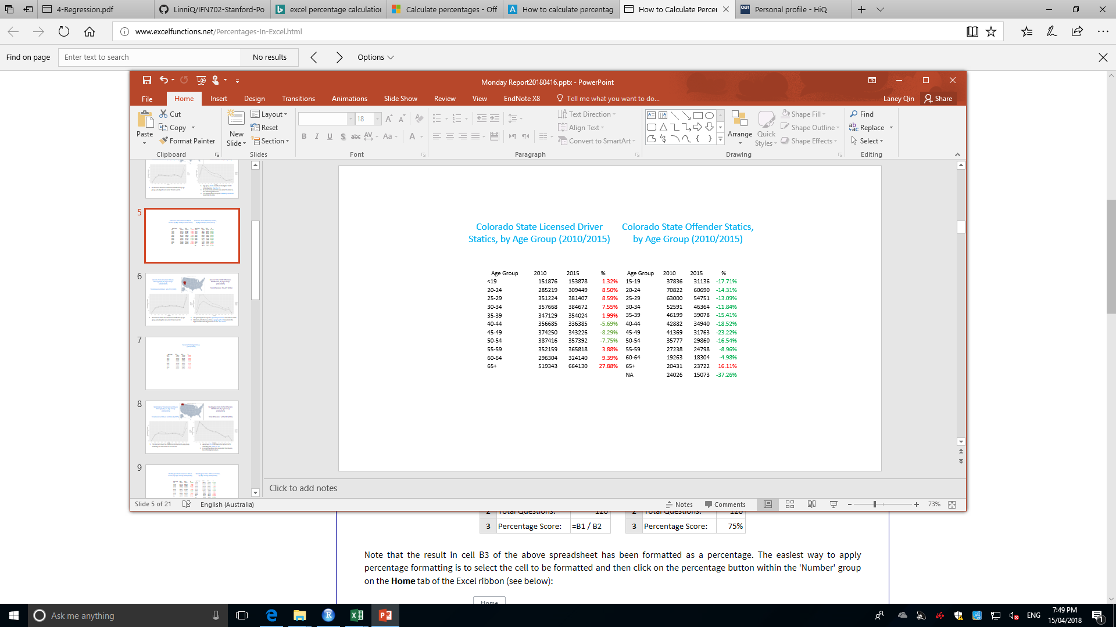
Colorado Traffic Violation and Age Groups Distribution (2010 vs. 2015)
Violation | 2010 | 2015 | Violation Up or Down | Age Group Statics Review
Speeding | Highest: 20-24 then 25- 29. More elder Less violation | Highest: 20-24 then 25- 29. More elder Less violation | 2010 > 2015 (2010 = (1+7.2%)*2015)
DUI | Highest: 20-24 then 25- 29. More elder Less violation | Highest: 20-24 then 25- 29. More elder Less violation | 2010 > 2015 (2010 = (1+36.96%)*2015)
Cell phone | N/A | Highest: 25-29 Highest: 20-24 nearly = 30-34 >35 years old, the violation decreased gradually. | N/A
IS THE INCREASE OF THE VIOLATION DETERMINED BY THE INCREASE OF THE DRIVER? YES – by exploring the violation in age groups of Colorado.

Slide 16
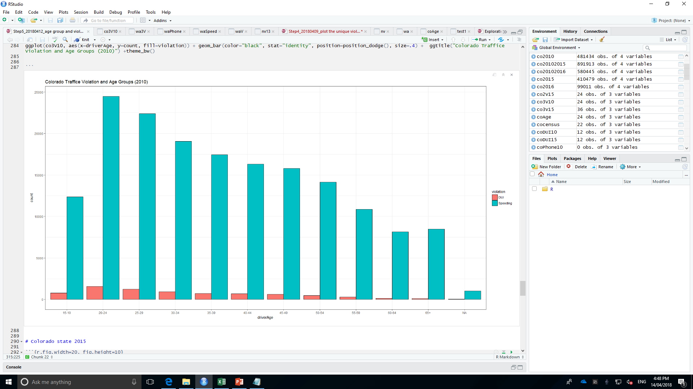
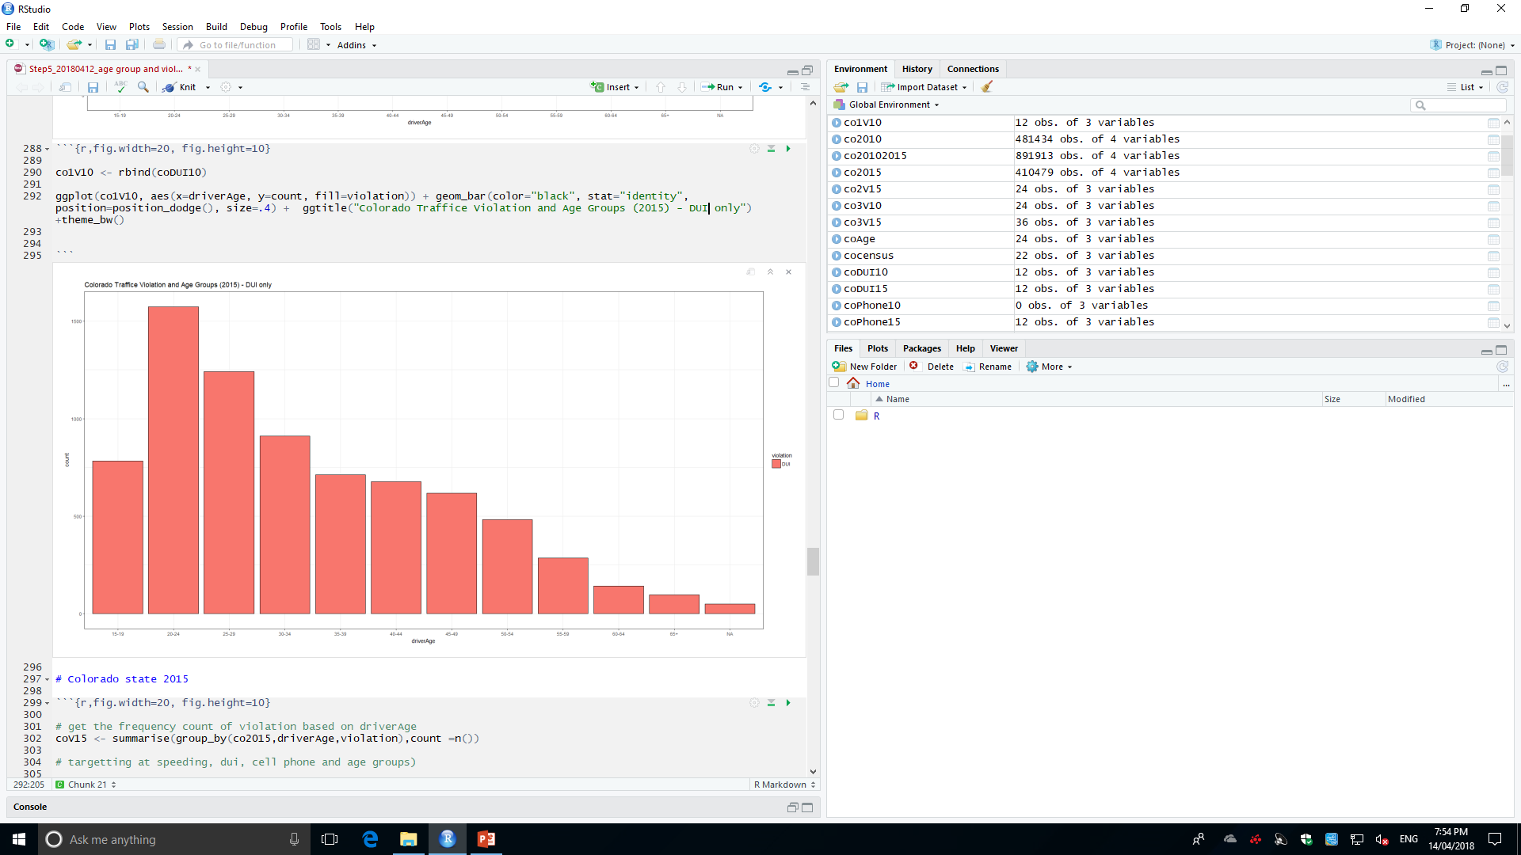
Colorado Traffic Violation and Age Groups Distribution (2010)
Similar with the distribution of Washington 2009. Speeding and DUI violation, age group 20-24 contribute the highest rate, then 25- 29. It can be concluded that more elder the driver is, less offending behaviours relevant to speeding and dui.
No record for cell phone violation in 2010.
DUI: Highest: 20-24 then 25- 29. More elder Less violation

Slide 17
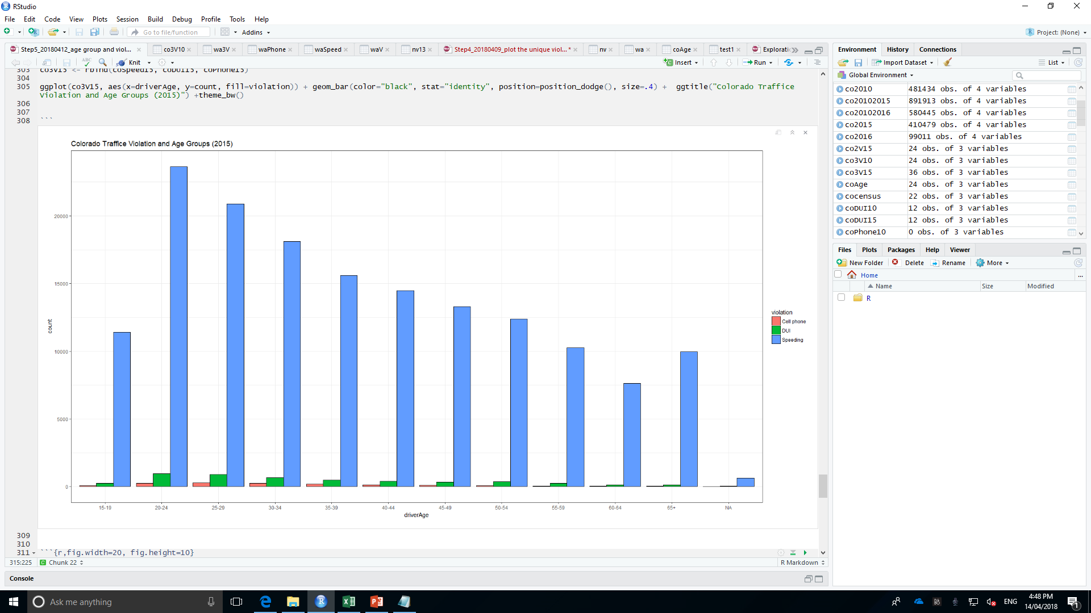
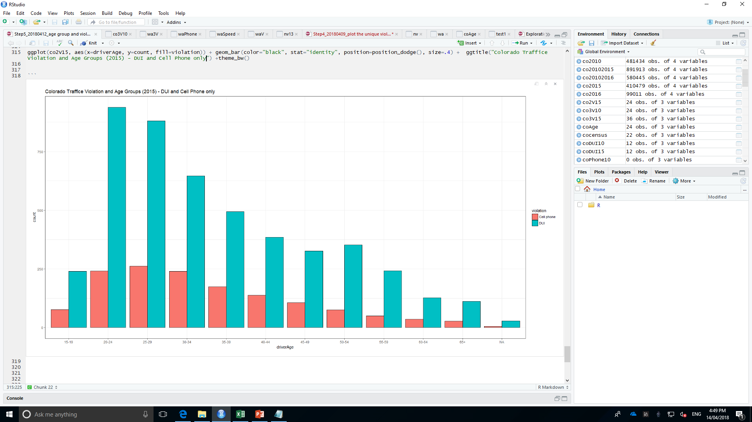
Colorado Traffic Violation and Age Groups Distribution (2015)
Two charts presents similarly with those of Washington 2009.
Speeding and DUI violation: age group 20-24 contribute the highest rate, then 25- 29. It can be concluded that more elder the driver is, less offending behaviours relevant to speeding and dui.
Cell phone violation: Drivers (25-29) highest; Drivers (20-24, 30-34) take the second highest that contribute equally as the second mostly offenders. Starting from 35 years old, the violation decreased gradually.

Slide 18
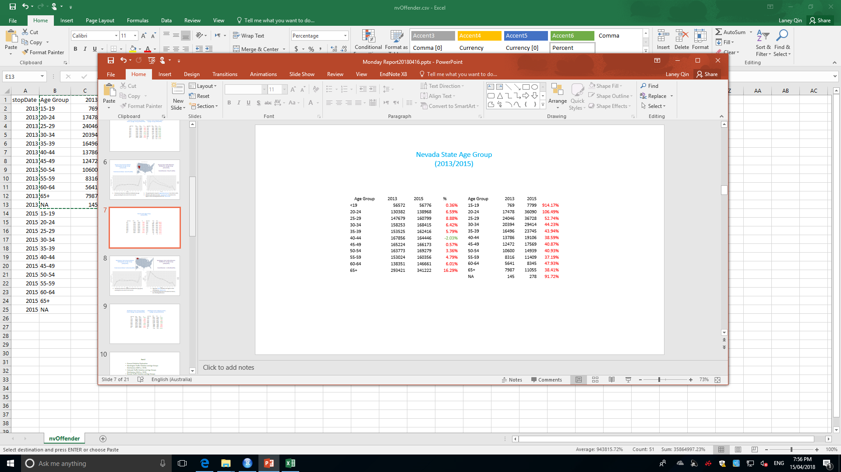
Nevada Traffic Violation and Age Groups Distribution (2013 vs. 2015)
Violation | 2013 | 2015 | Violation Up or Down | Age Group Statics Review
Speeding | Highest: 25-29 then 30- 24. More elder Less violation | Highest: 20-24 then 25- 29. More elder Less violation | 2009 < 2015 [2009 = (1- 71.5%)*2015]
DUI | Highest: 25-29 then 30- 24. More elder Less violation | Highest: 20-24 then 25- 29. More elder Less violation | 2009 < 2015 (2015 = 14.87 * 2009)
Cell phone | Highest: 25-29 then 20- 24. More elder Less violation | Highest: 25-29 then 20- 24. More elder Less violation | 2009 < 2015 [2015 = (1+ 46.69%) * 2009]
IS THE INCREASE OF THE VIOLATION DETERMINED BY THE INCREASE OF THE DRIVER? YES – by exploring the violation in age groups of Nevada.

Slide 19
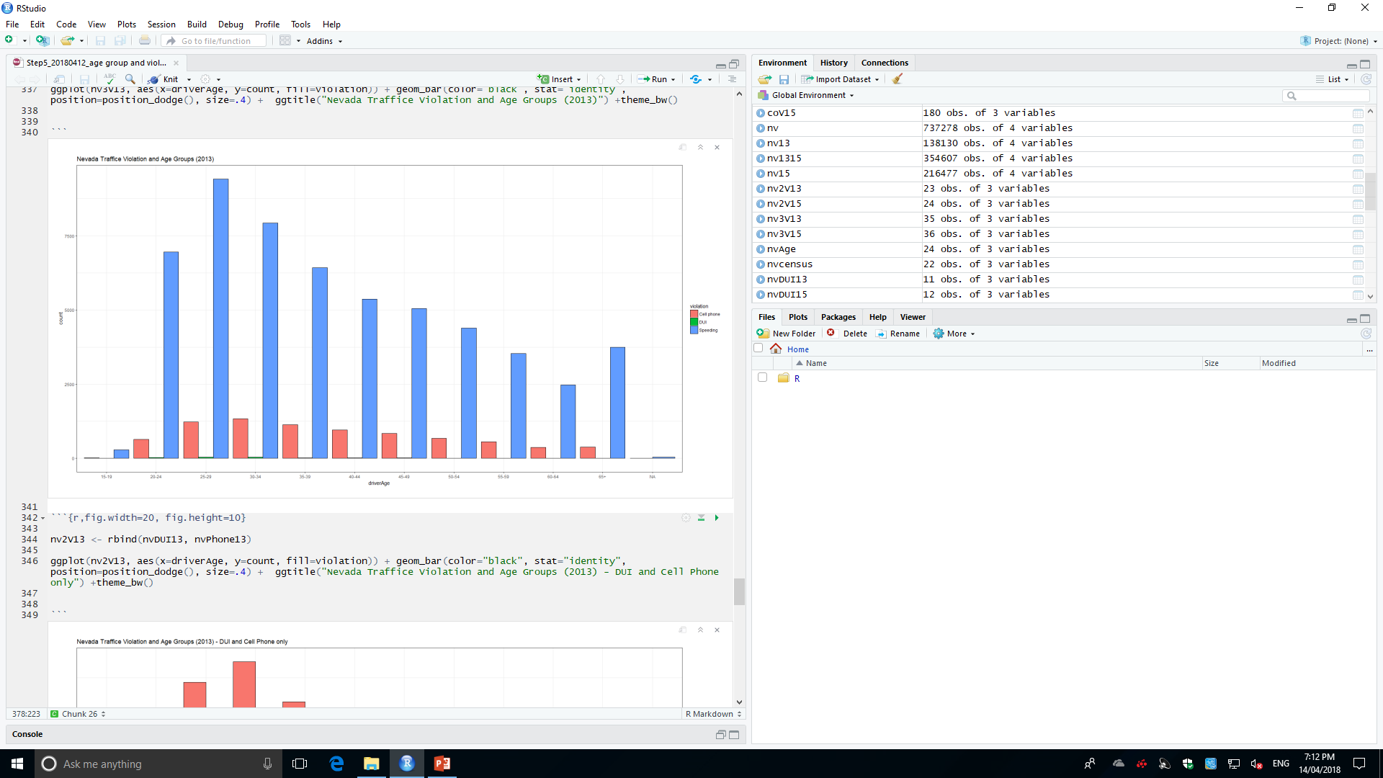
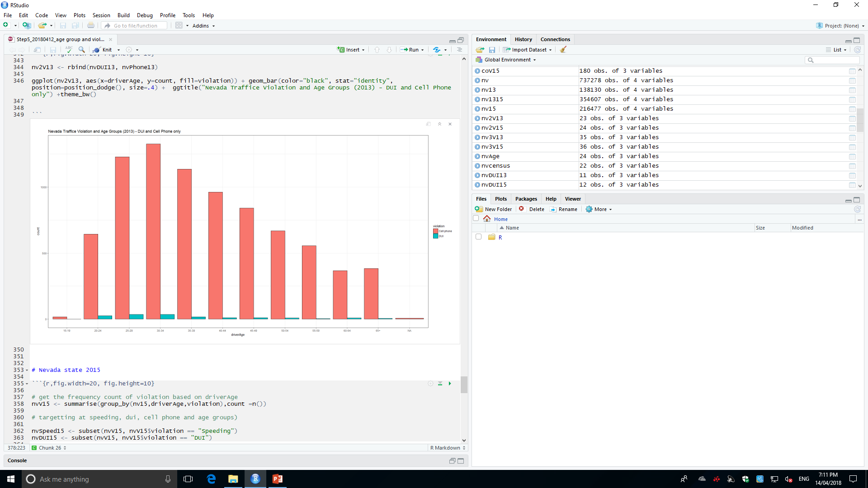
Nevada Traffic Violation and Age Groups Distribution (2013)

Slide 20
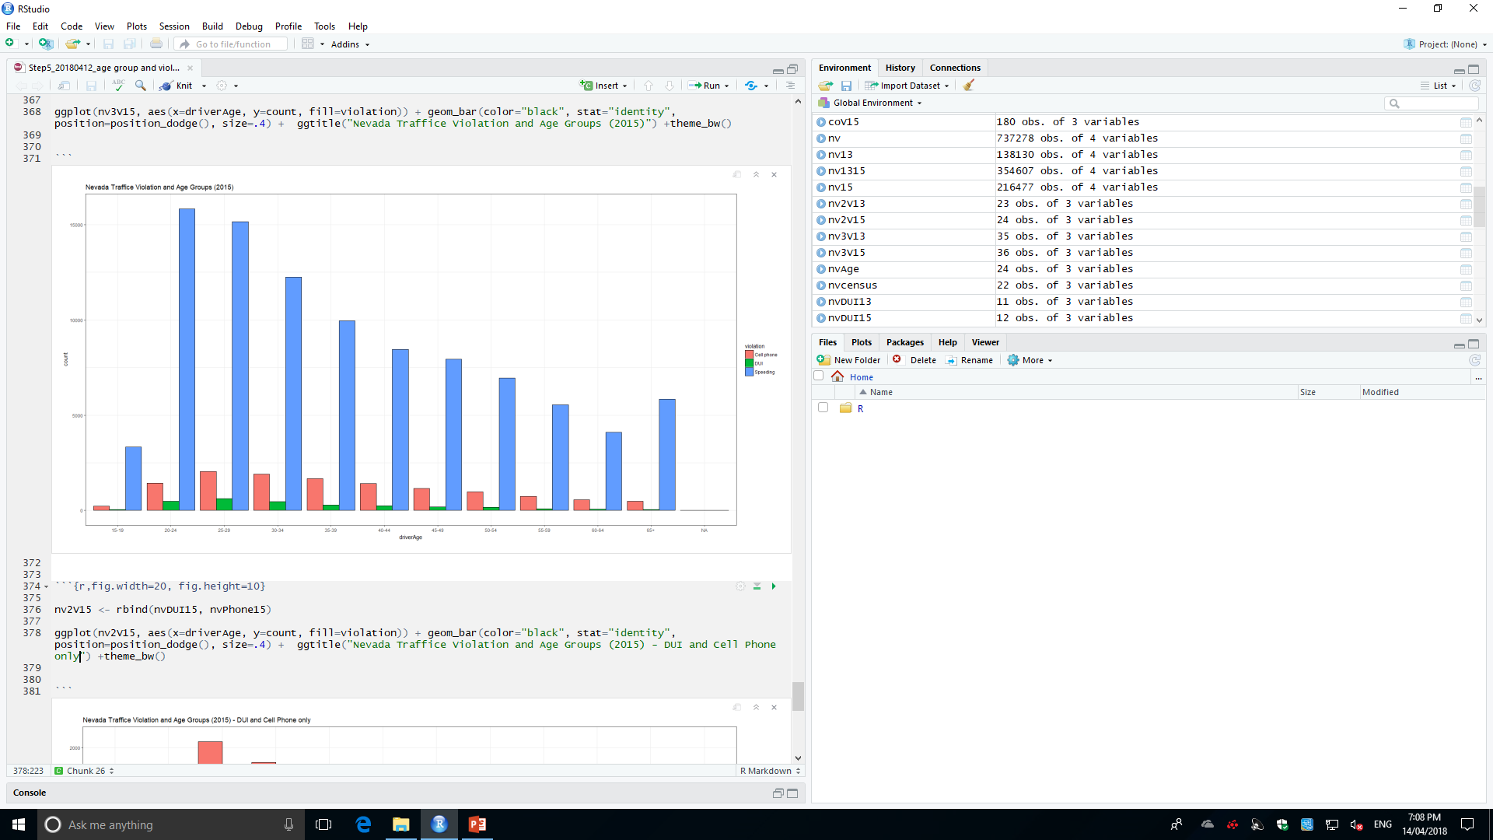
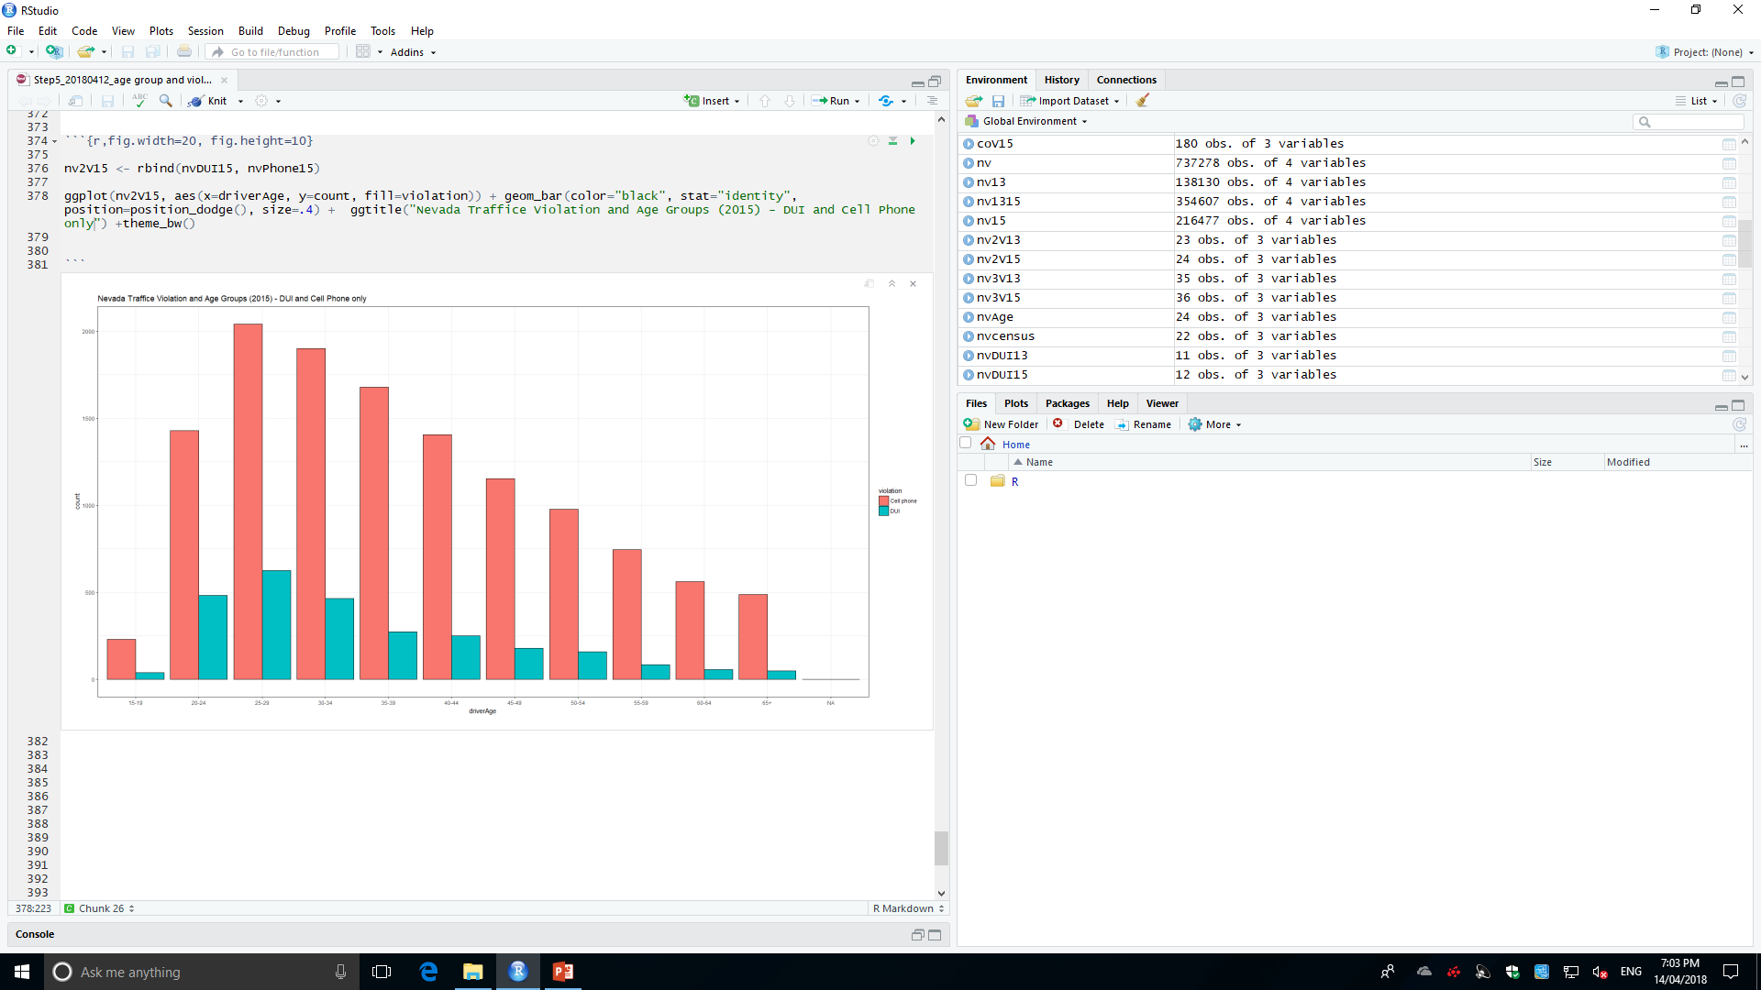
Nevada Traffic Violation and Age Groups Distribution (2015)

Slide 21
Conclusion Review
IS THE INCREASE OF THE VIOLATION DETERMINED BY THE INCREASE POPULATION OR LICENSED DRIVER? NO – by exploring the total amount of population, driver and violation.
YES – by exploring the violation distribution of age groups in Colorado State
YES – by exploring the violation distribution of age groups in Nevada State
NO – by exploring the violation distribution of age groups in Washington State
Drivers with age 20-29 offend mostly Speeding, DUI and Cell Phone, then 30-34. It can be concluded that young driver is most likely to violate the traffic safety.
Extraordinary increase (50-100%) in the amount of traffic violation (Speeding, DUI, Cell Phone) in Nevada state from 2013 to 2015, even through the increase of driver appear normally (around 7%). (Reason?)

